Slide 2
Planting your garden(s)
Together, we are going to perform a Pull Request/Merge of your content in your Week 2 lab
If you’re not already at GitHub, navigate there and follow along
If you know what to do or have done any of the steps we’re about to, just follow along, or
Just do the steps

Slide 3
The week’s work
Today, you’re getting a repository that we’re going to use for the next 1.5 weeks
We will gain:
Practice in HTML/CSS
Experience doing more “responsive” design
We’ve already been kinda doing this
This time it’s via something called
Collective knowledge in Javascript
At the end, a cool game

Slide 4
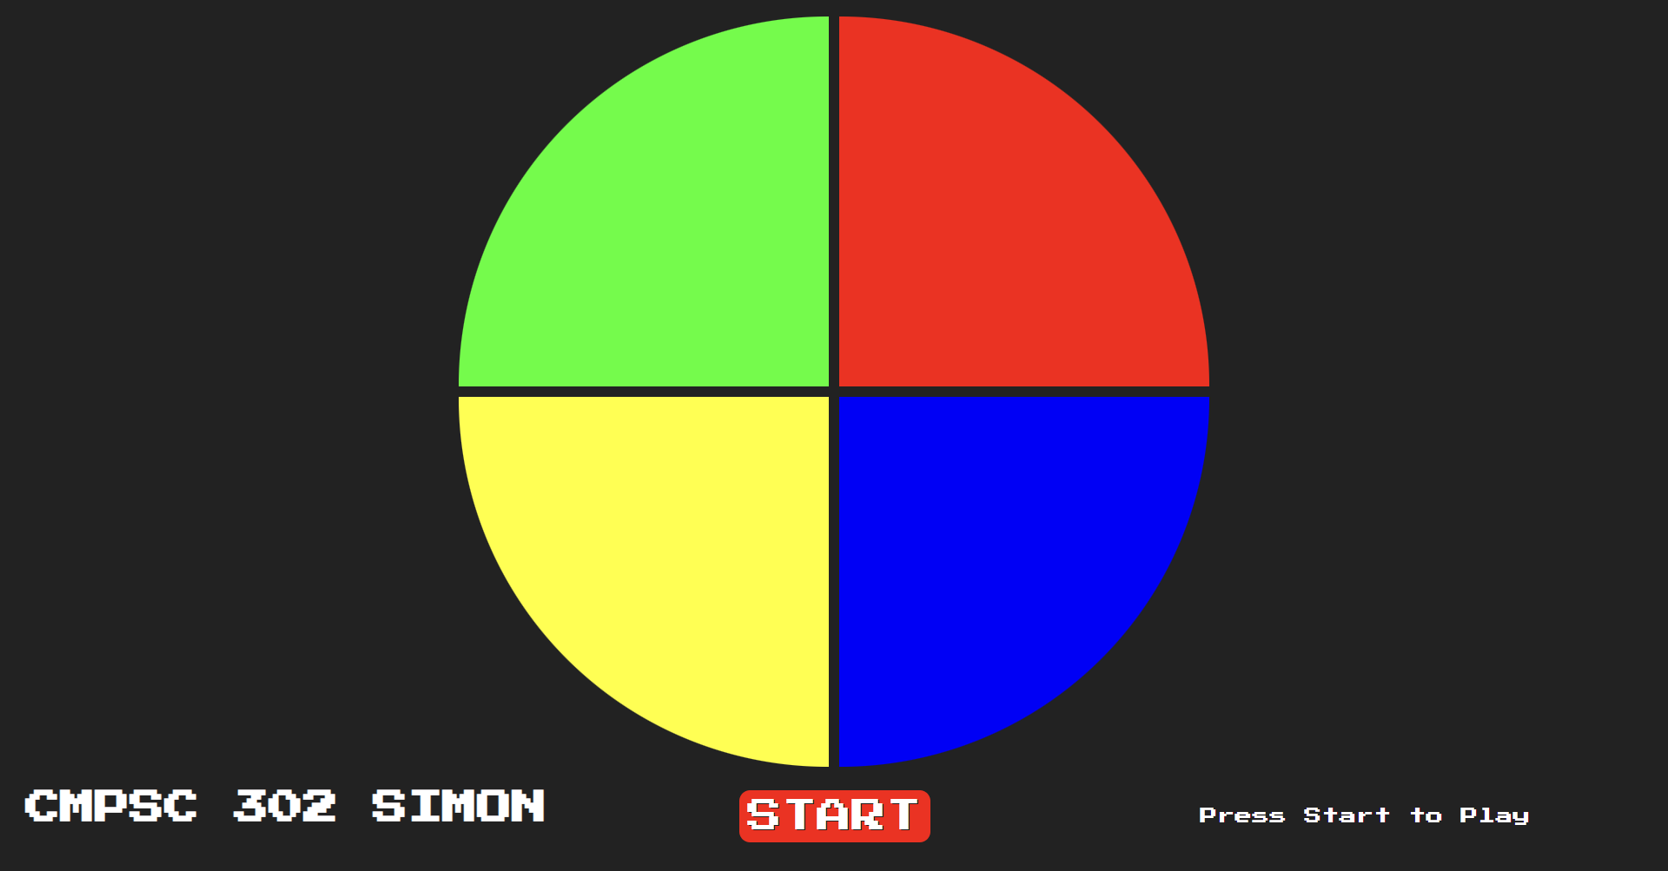
Simon says
Your job today (and partially Friday) is to make a layout.
Our layout should look like:

Slide 5
New tools
To make our touchpads, we’re going to use:
<button></button>

Slide 6
Simon says
Rules are in the README, but:
Name the IDs the names specified in the document
Follow other guidelines
We will tackle the “mobile” part together
This will involve learning something new, but likely on Friday
Today is dedicated to work time

Slide 7
Media training
We have the ability to change our designs in response to changing screen conditions
Hence “responsive”
Typically, this responds to widths and screen “orientations”
Screen sizes are typically demoninated in “pixels”
This is one of the few times that it’s pretty much the only way
CSS “Media Queries” accomplish this

Slide 8
Media training
screen size
@media only screen and (max-width: 1024px) {
#selector {
property: value;
}
}

Slide 9
Media training
screen orientation
@media only screen and (orientation: landscape) {
#selector {
property: value;
}
}

Slide 10
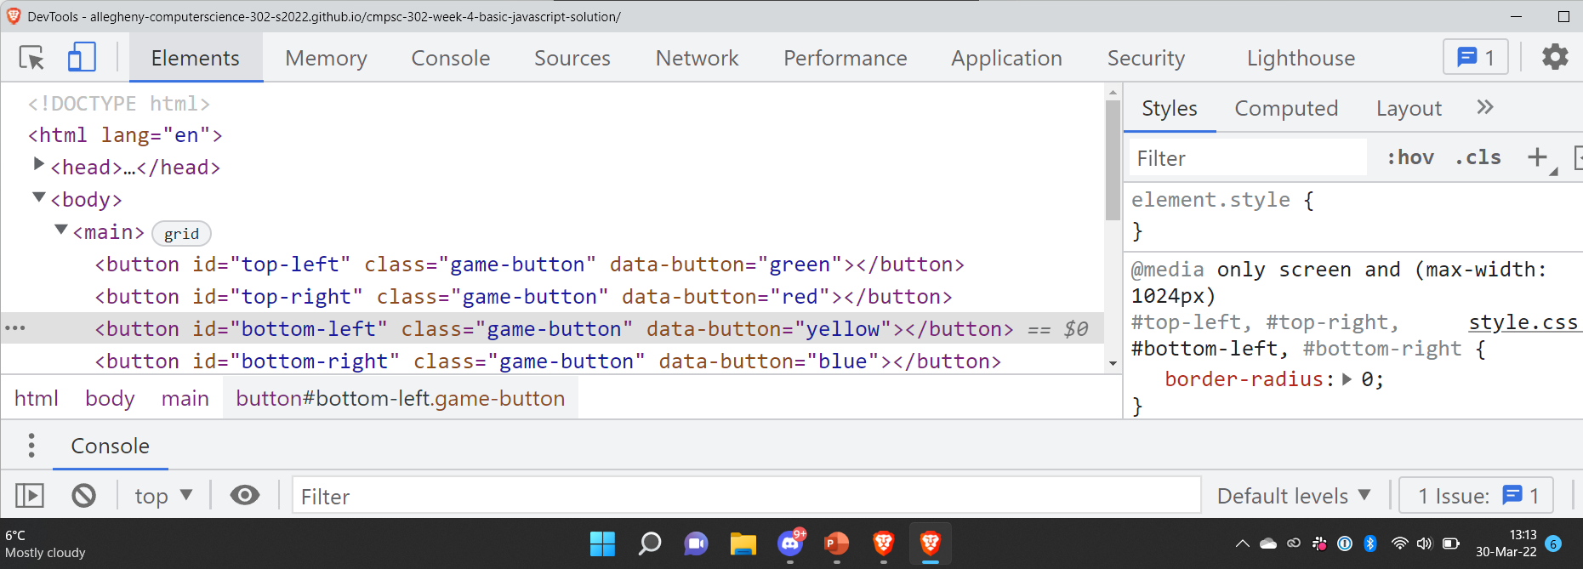
Media training
We can simulate these in our “inspect” mode:

